Slide 1





TerraNest
BY
Md. Asad Reyaz | (12200121014)
Tanir Sahoo | (12200121057)
Sankha Sengupta | (12200221047)
Aman Kumar Shah | (12200121038)
Under the guidance of
Samrat Sarkar
&
Silpi Ghosh
Assistant Professor, Department of Computer Science Engineering

Slide 2



TABLE OF CONTENTS
01
05
INTRODUCTION
PROJECT PROGRESS
02
PROJECT WORKFLOW
06
INDIVIDUAL CONTRIBUTION
03
USE CASE DIAGRAM
07
CONCLUSION
04
CURRENT STATUS OF PROJECT

Slide 3

Introduction
The traditional process of finding Paying Guest (PG) accommodations often suffers from outdated listings, unverified information, and a lack of personalized recommendations, making it inefficient for students and working professionals.
To address these issues, the Smart PG Recommendation Website offers an intelligent, scalable platform designed to modernize the PG search experience. Built using Spring Boot for the backend, MySQL for data storage, and HTML/CSS/JavaScript for the frontend, the website ensures a smooth and responsive user interface.
At the core of the platform is a rule-based recommendation engine that prioritizes search results based on location, cost, PG type, and amenities, tailored to users’ preferences and past interactions.
Key features include dynamic filtering, verified listings, and a review/rating system to improve decision-making.
The system also emphasizes security and privacy with GDPR compliance, secure APIs, encrypted communications, and robust access controls.
Deployed on cloud infrastructure, the platform ensures high availability, scalability, and a fast, secure, and personalized PG search experience.

Slide 4
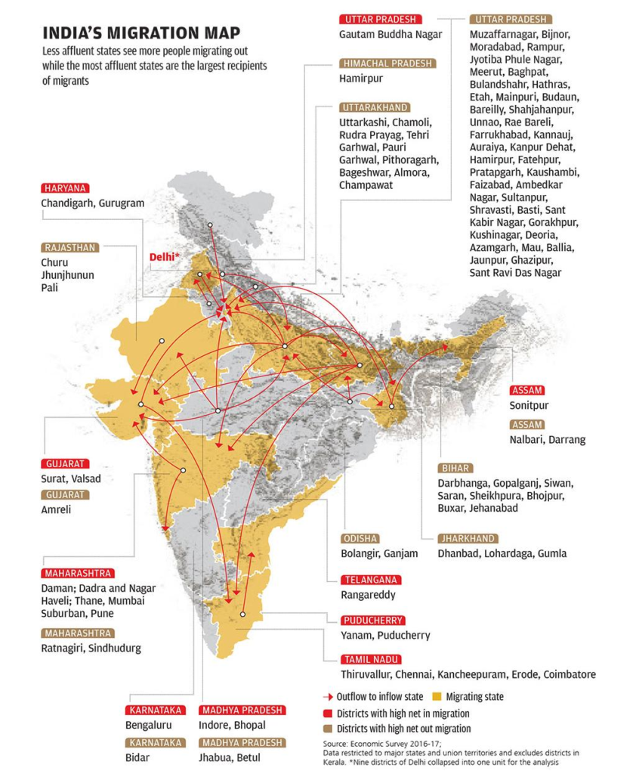
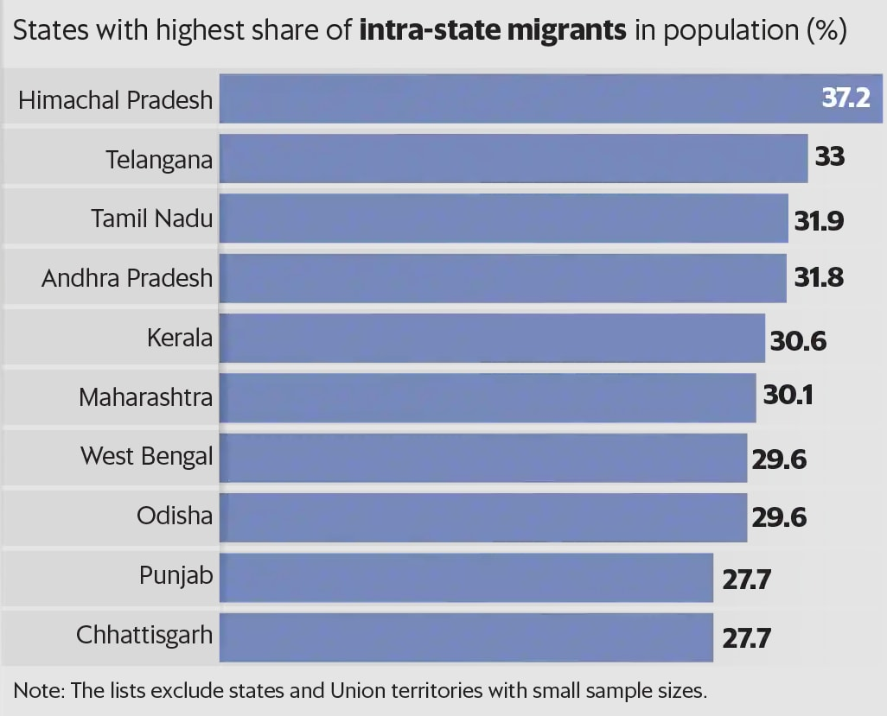
Real Problem & Market Analysis

Slide 5
Uniqueness & Objectives of the Project
Create a secure and scalable PG specific Platform.
Maintaining consistency and keeping track of the outdated PG’s.
ML based Recommendation Model.
Primary Goal: Simplify and personalize PG accommodation search for students and professionals using modern web and ML techniques.
Specific Objectives:
Develop an intelligent rule-based recommendation engine.
Create a secure and scalable web platform (Spring Boot, MySQL).
Improve search efficiency with dynamic filters.
Enhance transparency and trust via verified listings and user reviews.
Ensure data privacy and security (GDPR, encryption).
Deploy on cloud infrastructure for availability and performance.

Slide 6
Literature Survey
Traditional Platforms: 99acres, MagicBricks – generalized, lack nuance for PG needs.
AI/ML Integration: Vital for user experience in rental domain, e.g., content-based, collaborative, hybrid filtering.
Existing PG Platforms (NestAway, Zolo Stays, Colive): Leverage ML, but often rely on static filtering, overlooking behavioral trends.
TerraNest Innovation:
Rule-based recommendation system dynamically analyzes user interaction data (search frequency, filters, geo-interest).
Interpretable, faster to implement, well-suited for structured use-cases.
Addresses outdated listings, incorrect pricing.
Advanced filtering: gender-specific, meal inclusion, WiFi, room-sharing.
Innovative features: Roommate Compatibility Survey, Local Landmark Intelligence Module.
Comparison: TerraNest purpose-built for PG, focuses on behavioral analysis and context-aware features.

Slide 7
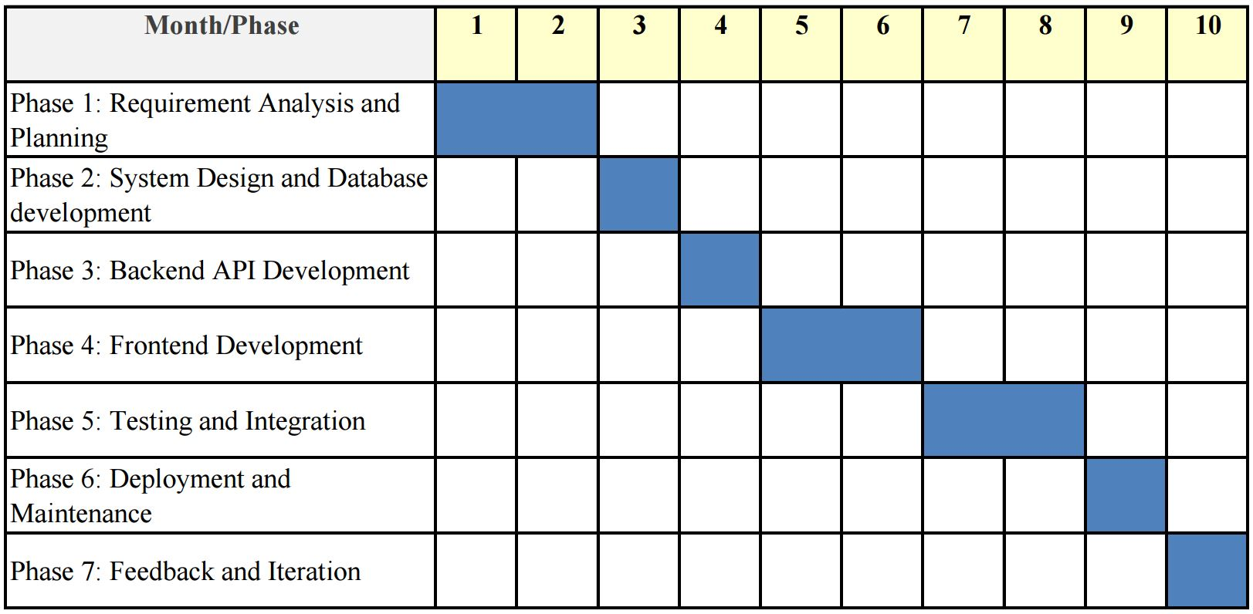
Feature Description and Timeline
User Registration (Email Verification with password hashing)
Content filtering based on different parameters.
Content searching using ML based keyword extraction model.
Recording user activity for ML based smart suggestion.
Secure Payment through Stripe.
Use of RESTAPI for cross server communication.

Slide 8
Tools and Platform
The system has been built using a robust and scalable architecture that integrates modern front-end and back-end technologies with a powerful machine learning engine. Designed for efficiency, modularity, and ease of development, the architecture ensures smooth interaction between components, seamless deployment, and optimal performance across different layers. Below is a detailed breakdown of the technologies, tools, and configurations used in the development and deployment of the application.
Frontend: HTML, CSS, JavaScript
Backend: Spring Boot , Python (ML Models)
Key Python libraries: Flask, requests, nltk, sentence-transformers, torch, SciPy, transformers, NumPy
Database: MySQL
Folder Structure of our project:
College_project
Documents
{SRS , ER , Synopsys , Report etc}
Front_end_files
{HTML , CSS and JS Codes with everypage in Modular Format}
MLTest
{All the sample datasets and ML Model Codes}
Rental_project_work
{Spring Boot backend Server Code}
venv
{Other required python frameworks and libraries}
LICENSE
README

Slide 9
Development Tools:
Visual Studio Code (VSCode) , IntelliJ IDEA
MySQL Workbench
Windows Subsystem for Linux (WSL)
Postman
GitHub Desktop , Google Chrome ,
Stripe (payment simulation)
Server Deployment and Configuration:
Component | Technology | Port | Role
Spring Boot Backend | Tomcat Server | 9000 | Exposes PG and bed data via REST APIs
ML Recommendation API | Flask Server (WSL) | 8000 , 7000 | Processes search queries and returns recommendations
Database Server | MySQL Server | 3306 | Manages structured PG data
Frontend Client | Apache Web Server | 5500 | Delivers the web-based user interface

Slide 10
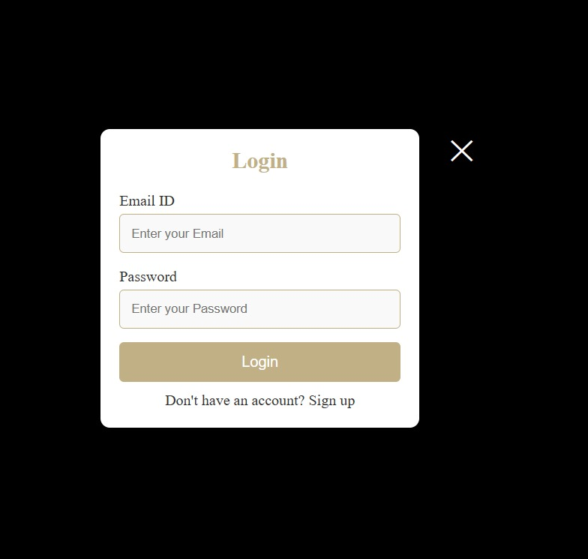
User Verification System
The User Verification System is a secure and efficient authentication mechanism that ensures only verified users gain access to the platform. By integrating email-based OTP verification using Flask and token-based email validation via Spring Boot, the system effectively minimizes the risk of fake or unauthorized registrations.
Ensures secure user registration through OTP/token-based email verification
Prevents fake/spam accounts by verifying emails before login access
Uses Flask for OTP-based API and Spring Boot for token verification logic
Encrypts passwords with BCrypt for strong data protection
Maintains session data securely during the verification process
Designed to be scalable and easily extendable with advanced security features

Slide 11
Keyword Extraction model
WHAT IS IT ?
To take a natural language search query (like: “Looking for a girls’ PG in Salt Lake with AC and food”) and return a ranked list of PGs from your database that semantically match this query — even if words don’t exactly match.
SOME IMPORTANT TERMS :
SENTENCE TRANSFORMER : A Sentence Transformer is a machine learning model that converts a sentence into a vector (called an embedding) that represents its meaning.
VECTOR : A vector is a list of numbers that represents something (in this case, a sentence). These numbers are learned from huge datasets during training (on Wikipedia, forums, QA sites, etc.) The model learns which words occur together, which contexts change meanings, etc.
COSINE SIMILARITY : Cosine similarity = How similar two vectors are in direction (not size). Ranges from -1 to 1 [1 = perfect match, 0 = no relation, -1 = completely opposite].
all-MiniLM-L6-v2 : all-MiniLM-L6-v2 is a pre-trained sentence transformer model created by Sentence-Transformers. It's designed to convert entire sentences or short paragraphs into fixed-size dense vectors (also called embeddings) that capture the meaning or semantic content of the text.

Slide 12
Working of the Keyword Extraction model
STEP 1 : Frontend sends the query to the ML model
STEP 8 : Return Results
sorted_indices = similarities.argsort(descending=True)
POST request is made to the Flask API endpoint /search
STEP 2 : Flask API receives the query
STEP 7 : Sort PGs by similarity
data = request.get_json()
query = data.get("value", "").strip()
similarities = util.cos_sim(query_embedding, pg_embeddings)[0]
STEP 3 : Flask calls Spring Boot to get PG data
STEP 6 : Semantic Comparison
pg_embeddings = model.encode(pg_texts, convert_to_tensor=True)
query_embedding = model.encode(query, convert_to_tensor=True)
pg_data = fetch_pg_data()
STEP 4 : Combine PG fields into text
STEP 5 : Sentence Encoding
text = prepare_pg_text(entry)

Slide 13
Smart Recommendation model
WHAT IS IT ?
A recommendation model is a system that suggests relevant items (like PGs, products, or movies) to users based on their preferences, behavior, or interactions. It helps users discover options they’re most likely to be interested in — saving time and improving experience.
WHY NECESSARY ?
Reason | Explanation
Personalized Suggestions | Shows PGs based on what a user previously liked or viewed.
No user-user dependency | Works even if there are no similar users
Efficient | Lightweight – only requires text data (not ratings or clicks).
Scalable | Can be applied to thousands of users/PGs without heavy computation.

Slide 14
IMPLEMENTATION TECHNIQUE :
Component | Why it's used
TF-IDF (Term Frequency-Inverse Document Frequency) | Gives importance to unique and meaningful keywords in PG descriptions. TF : How many times a word appears in PG’s description IDF : How rare the word is across all PGs
Cosine Similarity | Measures semantic similarity — even if exact words differ.
WORKING PROCEDURE :
Step 1 : Fetch User Activity from Database
Step 5 : Compare Profile with All PGs
df = fetch_user_activity_data()
tfidf = TfidfVectorizer(stop_words='english')
tfidf_matrix = tfidf.fit_transform(df['combined_features'])
cosine_similarity(target_profile, tfidf_matrix)
Step 2 : Combine Text Features
Step 3 : TF - IDF Vectorization
Step 4 : Build User Profiles
df['combined_features'] = description + facilities_for_bed
user_profiles = df.groupby('user_id').apply(lambda x: tfidf_matrix [x.index].mean (axis=0))

Slide 15



CONCLUSION
The TerraNest platform successfully addresses the challenges of traditional PG accommodation search by integrating modern web development with intelligent machine learning techniques. By offering a rule-based recommendation engine, secure user verification, and a dynamic, user-friendly interface, the system provides a tailored and trustworthy experience for users. It prioritizes verified listings, efficient search mechanisms, and behavioral analysis to deliver relevant suggestions.
With strong backend support, a modular ML engine, and deployment on scalable cloud infrastructure, TerraNest demonstrates innovation, practicality, and scalability in solving real-world housing search problems for students and professionals.

